Slide 1

Coursera Capstone Project IBM Applied Data Science Capstone Opening a Home Brewed Beer Pub in Bogota
By Juan Sebastian Mejia Perez

Slide 2
Business Problem
Which would be the best location to open a "Home Brewed" Beer Pub in Bogota?
In oder to get an answer, we need to explore, segment and cluster neighbourhoods to know more about its venues or types of running businesses
The ideal location should be nearby nightlife zones, since party environments favor beer consumption or next to other beer pubs, since competition favors the attention and asures traffic of focused or niche groups (home brewed beer consumers).

Slide 3
Data Collection
Latitudes and Longitudes
Since there isn’t a database from latitudes and longitudes or Bogota and its neighbourhoods, it has to be manually obtained from Wikipedia and stored in a database as a Cloud Storage Object.
Venues
The information of venues within the areas of interest, was obtained through the Foursquare API.
Radius was set to 1Km and the number of venues to 100

Slide 4
Methodology
Construct the database for the selected neighbourhoods with their corresponding geographical coordinates
Import file to notebook on Cloud
Use Foursquare API to obtain venue data
Visualize neighbourhoods using Folium library
Exploring all neighbourhoods through the mean frequency of occurrence of each venue category
Perform Clustering on the data via the k-means clustering method
Visualize the clusters in a map using Folium
Select the cluster of interest
Find the neighbourhood that mostly meets investing criteria

Slide 5
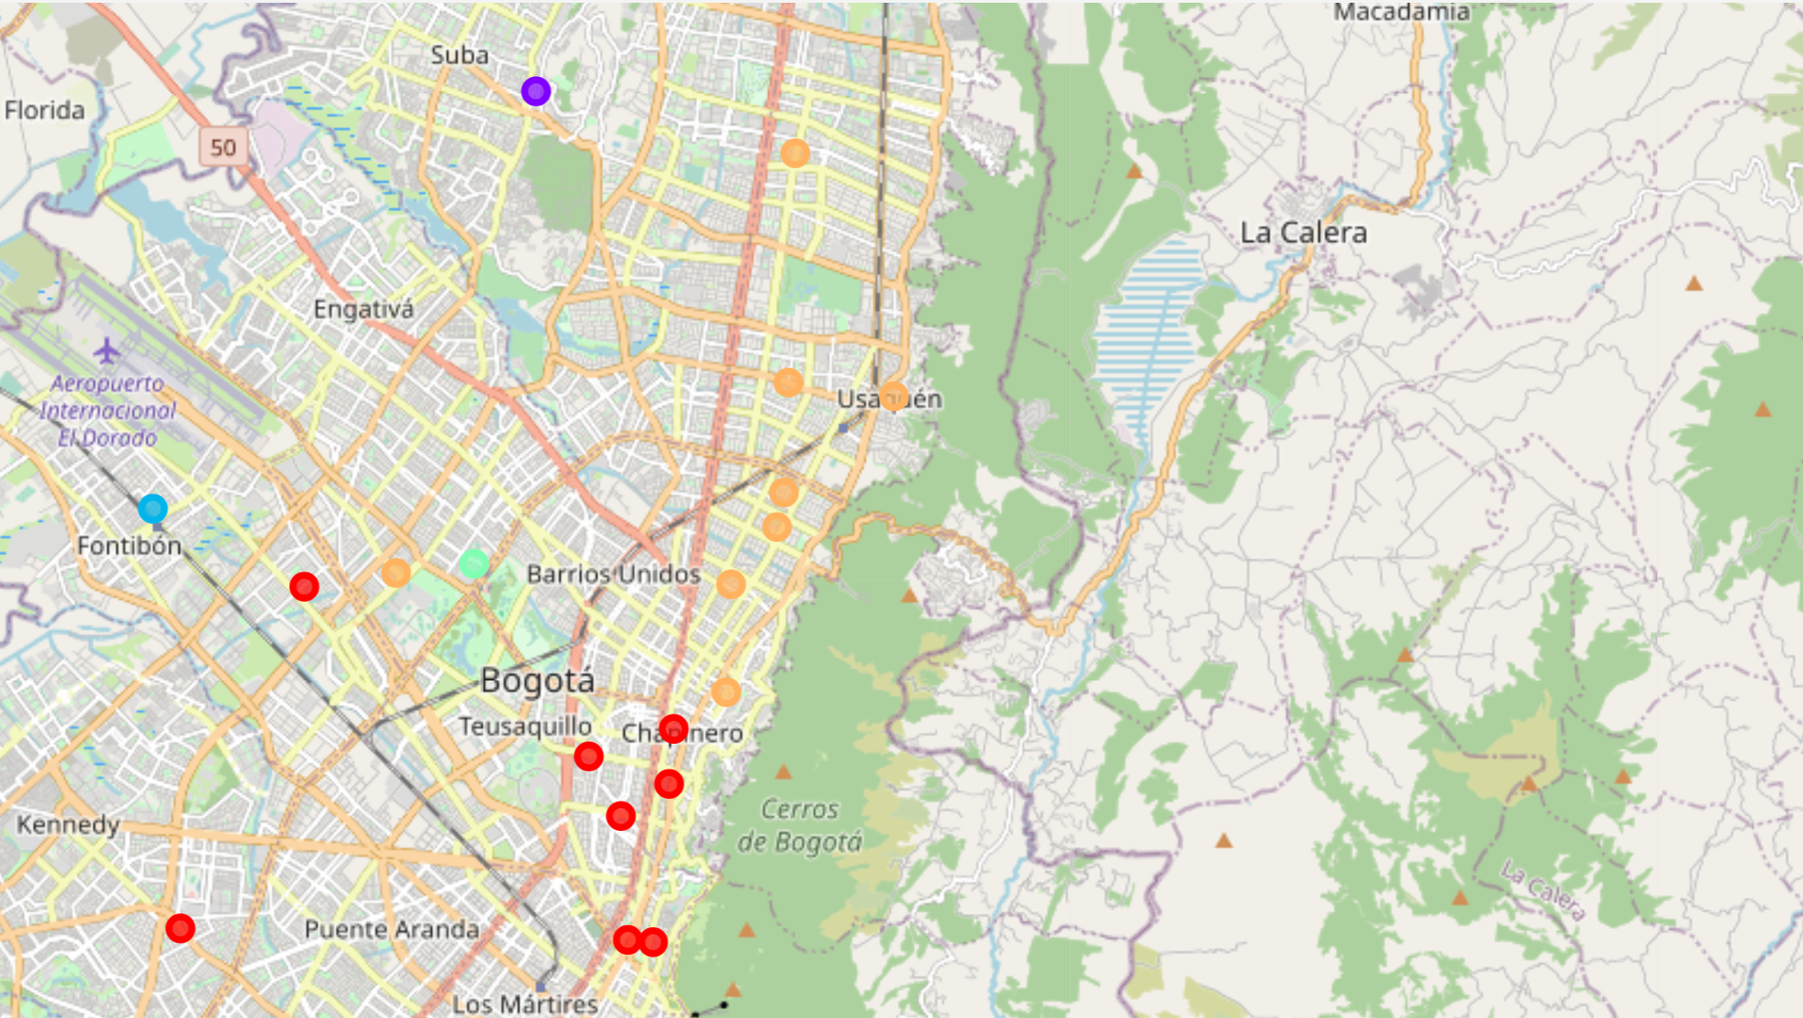
Results
5 clusters were created
4 of them look mostly familiar or residential neighbourhoods by the type of venues
1 cluster nicely selects the areas were most of the night life in Bogota occurs

Slide 6
Discussion
First cluster, only conformed by Teusaquillo, has nightclubs as it 7th most common venue, preceded by many businesses that can be seen as familiar or residential, therefore I will discard that one.
Second cluster is conformed by 8 neighbours, but can be seen on it that the night life is not exactly its main characteristic.
Third cluster, also conformed by 8 neighbours, gives a clearer idea of an entertainment zone combined with restaurants and an active night life, therefore I will focus on this one for making my decission.
The fourth cluster conformed only by Colina Campestre and the fifth by Fontibon, both seem just as familiar and residentials, therefor I will discard them.

Slide 7
Recommendations
Focusing on the selected "night life" cluster (No. 3) we still hadn't made the decission, since there are 8 possible neighbourhoods and I'm not able to open 8 Beer Pubs at a time, so lets find out the 3 perfect or ideal locations which I will have to explore then presencially on my own.
Note that Chapinero Alto, Marly and Galerias, have the most number of Bars and Nightclubs among its most common venues. Therefore, these are the best options for opening my Home Brewed Beer Pub.
A great way to start the presential search will be on CHAPINERO ALTO which has the most active night enironment, since restaurants, bars and nightclubs are among its Top 4 venues which is a guarantee of full traffic of potential home brewed beer consumers.

Slide 8
Conclusions
The most important conclusion I can get from this project is that Data Science is one of the most powerful existing decission tools and should be present in every real-world decission problem.
In this case, I started with a recommendation from friends of about 18 potential locations for my business, and after completing some hours of programming I was able to reduce my main options into 3, and for sure I have 1 main objective where to start. This process saved me a lot of precious time, not having to explore 18 zones presentially. And if worked for me, should work for anyone.

